Slide 1
502045
Software Engineering
Chapter 09
Lesson 13: Graphic User Interface
July 30, 2020
502045 - Graphic User Interface

Slide 2
User interface design
User interface design principles
User interaction
Information presentation
User support
Interface evaluation
July 30, 2020
502045 - Graphic User Interface

Slide 3
Information presentation
Information presentation is concerned with presenting system information to system users
The information may be presented directly (e.g. text in a word processor) or may be transformed in some way for presentation (e.g. in some graphical form)
The Model-View-Controller approach is a way of supporting multiple presentations of data
July 30, 2020
502045 - Graphic User Interface

Slide 4
The user interface
System users often judge a system by its interface rather than its functionality
A poorly designed interface can cause a user to make catastrophic errors
Poor user interface design is the reason why so many software systems are never used
July 30, 2020
502045 - Graphic User Interface

Slide 5
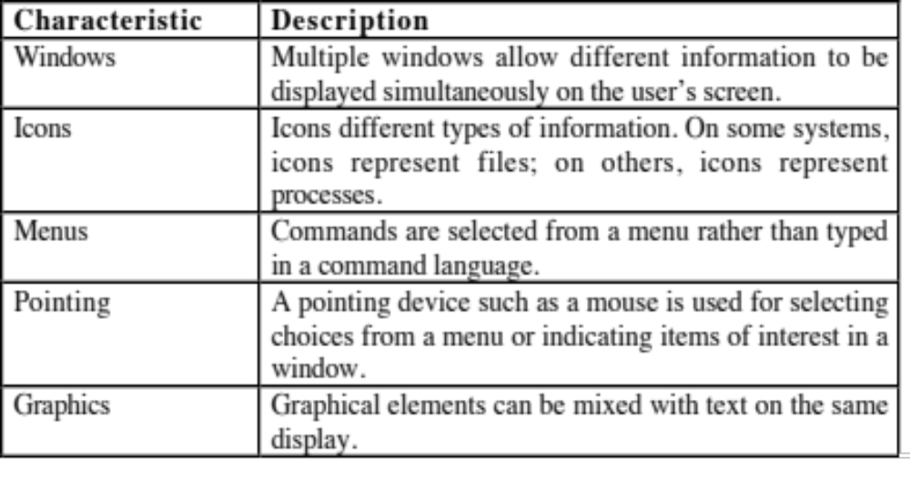
GUI characteristics
July 30, 2020
502045 - Graphic User Interface

Slide 6
User-centred design
The aim of this chapter is to sensitise software engineers to key issues underlying the design rather than the implementation of user interfaces
User-centred design is an approach to UI design where the needs of the user are paramount and where the user is involved in the design process
UI design always involves the development of prototype interfaces
July 30, 2020
502045 - Graphic User Interface

Slide 7
Design principles
User familiarity
  The interface should be based on user-oriented terms and concepts rather than computer concepts. For example, an office system should use concepts such as letters, documents, folders etc. rather than directories, file identifiers, etc.
July 30, 2020
502045 - Graphic User Interface

Slide 8
Design principles
Consistency
  The system should display an appropriate level
  of consistency. Commands and menus should have the same format, command punctuation should be similar, etc.
July 30, 2020
502045 - Graphic User Interface

Slide 9
Design principles
Minimal surprise
  If a command operates in a known way, the user should be able to predict the operation of comparable commands
July 30, 2020
502045 - Graphic User Interface

Slide 10
Design principles
Recoverability
  The system should provide some resilience to
  user errors and allow the user to recover from errors. This might include an undo facility, confirmation of destructive actions, 'soft' deletes, etc.
July 30, 2020
502045 - Graphic User Interface

Slide 11
Design principles
User guidance
  Some user guidance such as help systems, on-line manuals, etc. should be supplied
July 30, 2020
502045 - Graphic User Interface

Slide 12
Design principles
User diversity (variaty)
  Interaction facilities for different types of user should be supported. For example, some users have seeing difficulties and so larger text should be available
  Provide guidance, but power users require shortcuts
July 30, 2020
502045 - Graphic User Interface

Slide 13
User interface design
User interface design principles
User interaction
Information presentation
User support
Interface evaluation
July 30, 2020
502045 - Graphic User Interface

Slide 14
User-system interaction
Two problems must be addressed in interactive systems design
  How should information from the user be provided to the computer system?
  How should information from the computer system be presented to the user?
July 30, 2020
502045 - Graphic User Interface

Slide 15
Interaction styles
Direct manipulation
Menu selection
Form fill-in
Command language
Natural language
July 30, 2020
502045 - Graphic User Interface

Slide 16
Direct manipulation advantages
Users feel in control of the computer and are less likely to be intimidated by it
User learning time is relatively short
Users get immediate feedback on their actions so mistakes can be quickly detected and corrected
July 30, 2020
502045 - Graphic User Interface

Slide 17
Direct manipulation problems
The derivation of an appropriate information space model can be very difficult
Direct manipulation interfaces can be complex to program and make heavy demands on the computer system
July 30, 2020
502045 - Graphic User Interface
Notes:
May be hard to implement

Slide 18
Advantages of menu systems
Users need not remember command names as they are always presented with a list of valid commands
Typing effort is minimal
User errors are trapped by the interface
Context-dependent help can be provided. The user’s context is indicated by the current menu selection
July 30, 2020
502045 - Graphic User Interface
Notes:
Avoids user error because users no need to remember command names
little typing required

Slide 19
Problems with menu systems
Menu systems are best suited to presenting a small number of choices. If there are many choices, some menu structuring facility must be used
Experienced users find menus slower than
command language
July 30, 2020
502045 - Graphic User Interface
Notes:
Slow for experienced users
Can become complex if many menu options

Slide 20
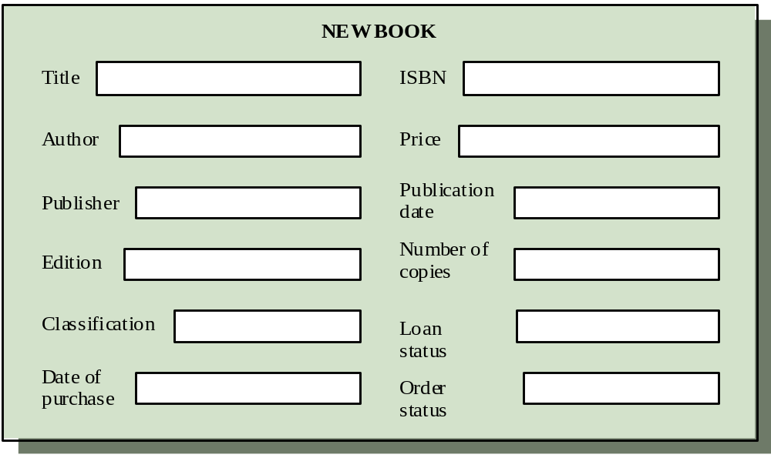
Form-based interface
July 30, 2020
502045 - Graphic User Interface
Notes:
Takes up a lot of screen space
Causes problems where user options do not match the form fields

Slide 21
Command languages
Often preferred by experienced users because they allow for faster interaction with the system
Not suitable for casual or inexperienced users
May be provided as an alternative to menu commands (keyboard shortcuts). In some cases, a command language interface and a menu-based interface are supported at the same time
July 30, 2020
502045 - Graphic User Interface
Notes:
Powerful and flexible

Slide 22
Problems with command interfaces
Users have to learn and remember a command language. Command interfaces are therefore unsuitable for occasional users
Users make errors in command. An error
detection and recovery system is required
System interaction is through a keyboard so typing ability is required
July 30, 2020
502045 - Graphic User Interface
Notes:
Hard to leam
Poor error management

Slide 23
Natural language interfaces
The user types a command in a natural language. Generally, the vocabulary is limited and these systems are confined to specific application domains (e.g. timetable enquiries)
NL processing technology is now good enough to make these interfaces effective for casual users but experienced users find that they require too much typing
Search engine
July 30, 2020
502045 - Graphic User Interface

Slide 24
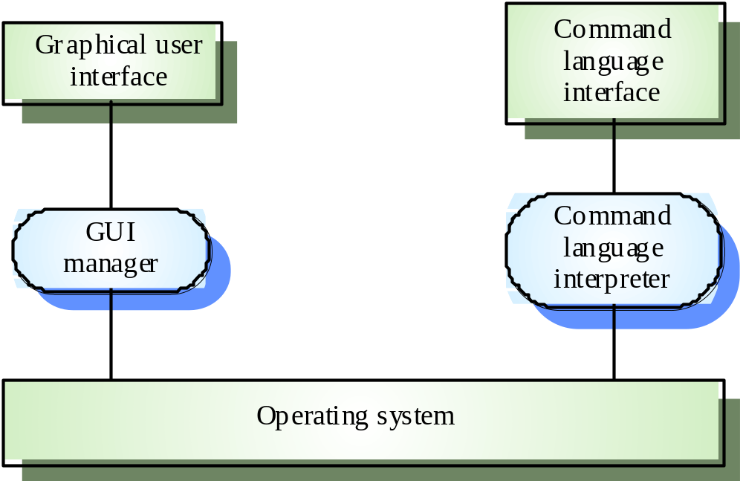
Multiple user interfaces
July 30, 2020
502045 - Graphic User Interface

Slide 25
User interface design
User interface design principles
User interaction
Information presentation
User support
Interface evaluation
July 30, 2020
502045 - Graphic User Interface

Slide 26
Information presentation
Text
Graphic
Color
July 30, 2020
502045 - Graphic User Interface

Slide 27
Information presentation
Information presentation is concerned with presenting system information to system users
The information may be presented directly (e.g. text in a word processor) or may be transformed in some way for presentation (e.g. in some graphical form)
The Model-View-Controller approach is a way of supporting multiple presentations of data
July 30, 2020
502045 - Graphic User Interface

Slide 28
Information presentation
Static information
  Initialised at the beginning of a session. It does not change during the session
  May be either numeric or textual
Dynamic information
  Changes during a session and the changes must be communicated to the system user
  May be either numeric or textual
July 30, 2020
502045 - Graphic User Interface

Slide 29
Information display factors
Is the user interested in precise information or data relationships?
How quickly do information values change?
Must the change be indicated immediately?
Must the user take some action in response to a change?
Is there a direct manipulation interface?
Is the information textual or numeric? Are relative values important?
July 30, 2020
502045 - Graphic User Interface
Notes:
factors: các yếu tổ

Slide 30
Textual vs graphics
can take a long time to download if the user is working over a slow, dial-up connection (not graphic)
precise information (text) vs relationships between data (graphic)
changes relatively slowly (text) vs changes quickly (graphic)
July 30, 2020
502045 - Graphic User Interface

Slide 31
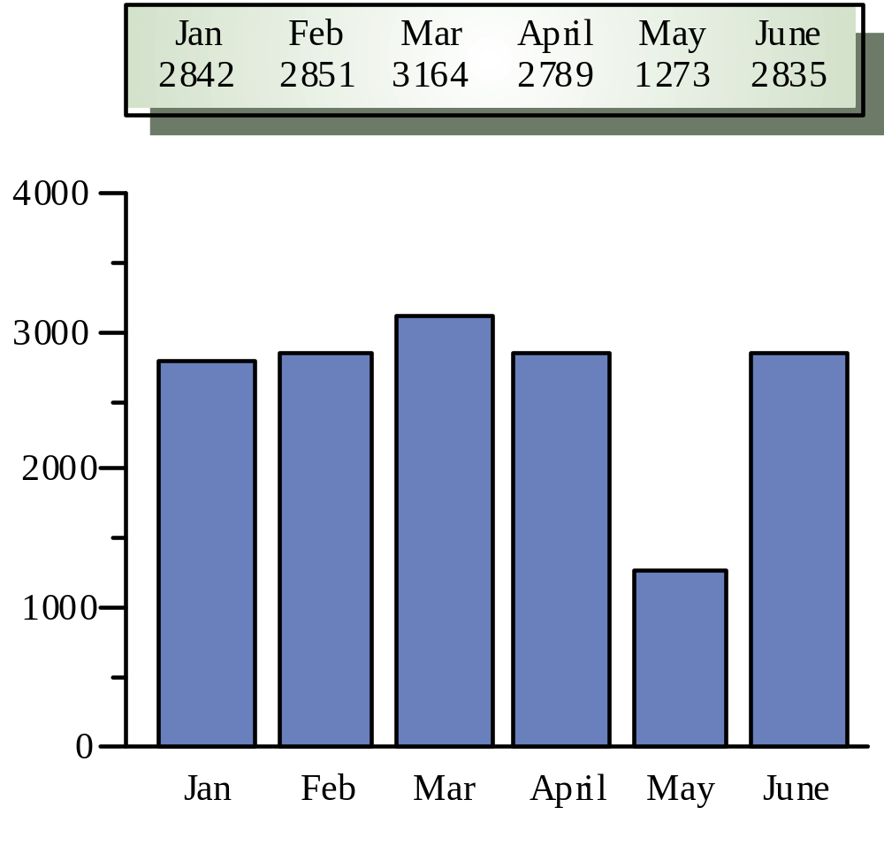
Alternative information presentations
July 30, 2020
502045 - Graphic User Interface

Slide 32
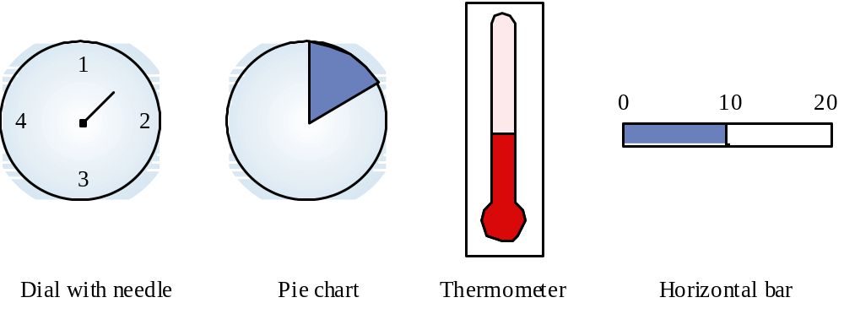
Dynamic information display
July 30, 2020
502045 - Graphic User Interface

Slide 33
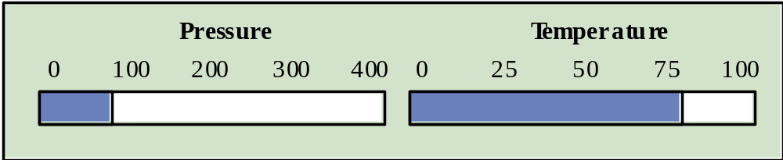
Displaying relative values
July 30, 2020
502045 - Graphic User Interface

Slide 34
Colour displays
Colour adds an extra dimension to an interface and can help the user understand complex information structures
Can be used to highlight exceptional events
Common mistakes in the use of colour in
interface design include:
  The use of colour to communicate meaning
  Over-use of colour in the display
July 30, 2020
502045 - Graphic User Interface

Slide 35
Colour use guidelines
Don't use too many colours
Use colour change to show a change in system status
Allow users to control colour coding
Design for monochrome then add colour
July 30, 2020
502045 - Graphic User Interface

Slide 36
Colour use guidelines
Use colour coding consistently
Avoid colour pairings which clash
Be aware that colour displays are usually lower resolution
you should use colour for highlighting, but you should not associate meanings with particular colours
July 30, 2020
502045 - Graphic User Interface

Slide 37
Key points
Systems should provide on-line help. This should include “help, I’m in trouble” and “help, I want information”
Error messages should be positive rather than
negative.
A range of different types of user documents should be provided
Ideally, a user interface should be evaluated against a usability specification
July 30, 2020
502045 - Graphic User Interface

